Slide 1
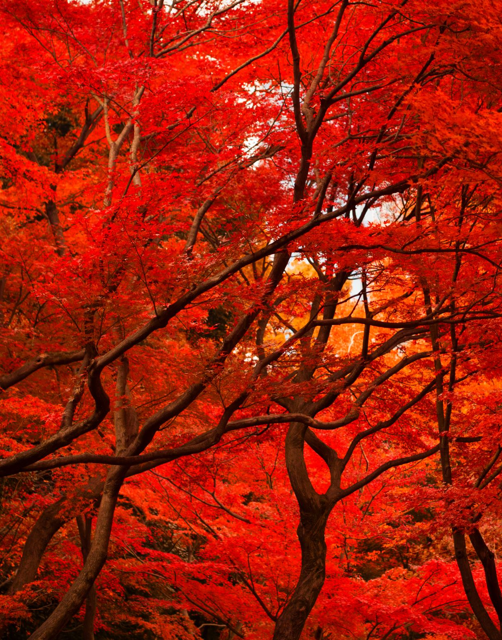
Red Black Trees
Prof. Prateek Vishnoi
Dr. Vipin kumar

Slide 2
Properties
A red-black tree is a binary search tree that satisfies the following :
Every node is either red or black.
The root is black.
Every leaf (NIL) is black.
If a node is red, then both its children are black.
For each node, all simple paths from the node to descendant leaves contain the same number of black nodes.

Slide 3
Insertion in RB Tree
Insert the node similarly as of BST.
If the node is ROOT node, make its color BLACK.
If the tree is not EMPTY, create newnode as leaf node with color RED.
If parent of newnode is BLACK, then EXIT.
If parent of newnode is RED, check color of UNCLE :
If color is BLACK or NULL, do suitable ROTATION and RECOLOR.
If color is RED, then RECOLOR, check if parent’s parent is ROOT or not, if not then RECOLOR and RECHECK

Slide 4
Create a RB Tree with the following keys:
10, 18, 7, 15, 16, 30, 25, 40, 60, 2, 1, 70
10
7
18
15

Slide 5
10, 18, 7, 15, 16, 30, 25, 40, 60, 2, 1, 70
10
7
18
R-R conflict
15

Slide 6
10, 18, 7, 15, 16, 30, 25, 40, 60, 2, 1, 70
10
7
18
15

Slide 7
10, 18, 7, 15, 16, 30, 25, 40, 60, 2, 1, 70
10
7
18
15
R-R conflict
16

Slide 8
10, 18, 7, 15, 16, 30, 25, 40, 60, 2, 1, 70
10
10
7
18
7
18
Left Rotation
15
16
R-R conflict
16
15

Slide 9
10, 18, 7, 15, 16, 30, 25, 40, 60, 2, 1, 70
10
10
7
18
7
16
Right Rotation
16
15
18
15

Slide 10
10, 18, 7, 15, 16, 30, 25, 40, 60, 2, 1, 70
10
10
Recoloring
7
16
7
16
15
18
15
18

Slide 11
10, 18, 7, 15, 16, 30, 25, 40, 60, 2, 1, 70
10
10
Recoloring
7
16
7
16
15
18
15
18
R-R conflict
30
30

Slide 12
10, 18, 7, 15, 16, 30, 25, 40, 60, 2, 1, 70
10
10
7
16
7
16
Recoloring
15
18
15
18
30
30

Slide 13
10, 18, 7, 15, 16, 30, 25, 40, 60, 2, 1, 70
10
10
7
16
7
16
15
18
Right Rotation
15
18
30
25
R-R conflict
25
30

Slide 14
10, 18, 7, 15, 16, 30, 25, 40, 60, 2, 1, 70
10
10
7
16
7
16
15
18
Left Rotation
15
25
25
18
30
30

Slide 15
10, 18, 7, 15, 16, 30, 25, 40, 60, 2, 1, 70
10
10
7
16
7
16
Recoloring
15
25
15
25
18
30
18
30

Slide 16
10, 18, 7, 15, 16, 30, 25, 40, 60, 2, 1, 70
10
10
7
16
7
16
Recoloring
15
25
15
25
18
30
18
30
R-R conflict
40
40

Slide 17
10, 18, 7, 15, 16, 30, 25, 40, 60, 2, 1, 70
10
10
7
16
7
16
R-R conflict
Recoloring
15
25
15
25
18
30
18
30
40
40

Slide 18
10, 18, 7, 15, 16, 30, 25, 40, 60, 2, 1, 70
10
16
7
16
10
25
Left Rotation
15
25
7
15
18
30
18
30
40
40

Slide 19
10, 18, 7, 15, 16, 30, 25, 40, 60, 2, 1, 70
16
16
10
25
10
25
Recoloring
7
15
18
30
7
15
18
30
40
40

Slide 20
10, 18, 7, 15, 16, 30, 25, 40, 60, 2, 1, 70
16
16
10
25
10
25
Left Rotation
7
15
18
30
7
15
18
40
40
30
60
60

Slide 21
10, 18, 7, 15, 16, 30, 25, 40, 60, 2, 1, 70
16
16
10
25
10
25
INSERT 1
7
15
18
40
7
15
18
40
2
30
60
2
30
60
1

Slide 22
10, 18, 7, 15, 16, 30, 25, 40, 60, 2, 1, 70
16
16
10
25
10
25
Right Rotation
7
15
18
40
2
15
18
40
2
30
60
1
7
30
60
R-R conflict
1

Slide 23
10, 18, 7, 15, 16, 30, 25, 40, 60, 2, 1, 70
16
16
10
25
10
25
Recoloring
2
15
18
40
2
15
18
40
1
7
30
60
1
7
30
60

Slide 24
10, 18, 7, 15, 16, 30, 25, 40, 60, 2, 1, 70
16
16
10
25
10
25
INSERT 70
2
15
18
40
2
15
18
40
1
7
30
60
1
7
30
60
R-R conflict
70

Slide 25
10, 18, 7, 15, 16, 30, 25, 40, 60, 2, 1, 70
16
16
10
25
10
25
Recolor
2
15
18
40
2
15
18
40
1
7
30
60
1
7
30
60
R-R conflict
70
70

Slide 26
10, 18, 7, 15, 16, 30, 25, 40, 60, 2, 1, 70
16
16
10
25
10
25
Recolor
R-R conflict
2
15
18
40
2
15
18
40
1
7
30
60
1
7
30
60
70
70

Slide 27
10, 18, 7, 15, 16, 30, 25, 40, 60, 2, 1, 70
16
16
10
25
10
25
Recolor
2
15
18
40
2
15
18
40
1
7
30
60
1
7
30
60
70
70

